Slide 1

ENPM686: FINAL PROJECT - PRESENTATION
SECURING LIFECARE HOSPITAL
Submitted By:-
Krupa Solanki (118291208)
Ratan Gupta (118195773)

Slide 2
Table of Contents
Abstract
Assumptions
Current Architecture
Recent Compromises
Proposed Security Solutions
Conclusion

Slide 3
Abstract
LifeCare Hospital has been a victim of many security attacks in recent months including a severe ransomware attack and many DDoS (Distributed Denial of Service) attacks. The attacks have drastically impacted hospital services and patients. A majority of the patients’ PII (Personal Identifiable Information) and PHI (Protected Health Information) were stolen and hospital services were rendered unavailable for use.
The purpose of this design paper is to evaluate the overall security posture of LifeCare Hospital and identify vulnerabilities that led to the recent attacks and that can be potential vectors for future attacks. The paper also recommends security solutions to improve the overall security posture of LifeCare Hospital and build resilience against future attacks and mitigate risks.
Lastly, the paper includes the budget allocated for infrastructure assessment and solutions design, and provides an estimated cost for the recommended solutions.

Slide 4
Assumptions
A total of 150 employees.
No multi-factor authentication used.
A very basic firewall in-place.
Employees are not trained to follow the best security practices.
Systems do not have antimalware software and many systems are not regularly patched.
No logging and monitoring tool implemented.
Advanced security solutions such as IPS, vulnerability scanners, etc. are not being used.
Sensitive data is not encrypted.
Absence of security staff.

Slide 5
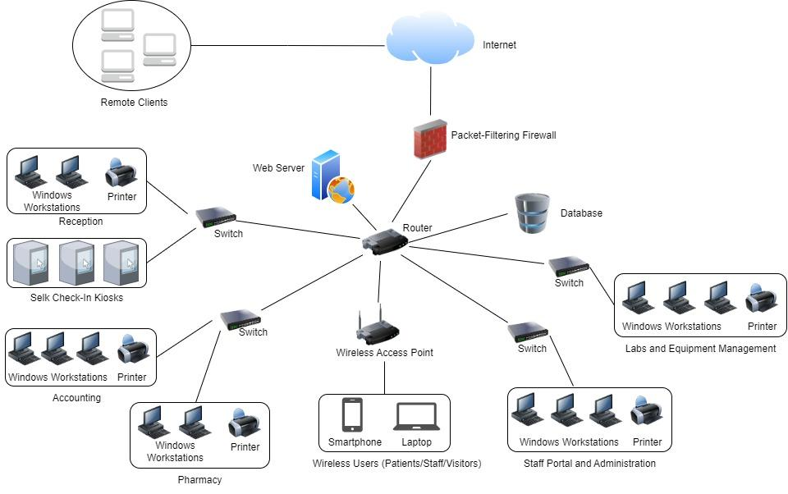
Current Architecture

Slide 6
Recent Compromises
LifeCare Hospital has suffered from the following recent attacks -
Ransomware attack
Causes - unpatched systems, no antimalware software, malicious emails, etc.
DDoS attack
Causes - insecure network, basic firewall, no scalability, etc.
Social Engineering attack (Phishing)
Causes - untrained and security-unaware employees, no security staff, etc.

Slide 7
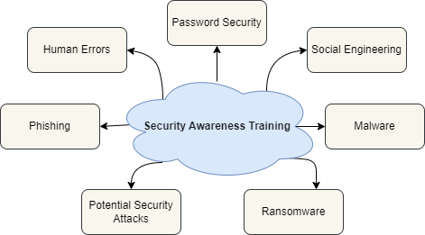
Security Awareness Training for Employees
Employees should be trained to follow best security practices.
Provides an understanding of the importance of security within the hospital.
States the importance of presence of a security team member in the organization.
It will help the the employees understand about password management, email security, and online privacy.
SANS offers a wide range of training resources and can be implemented by the hospital to train their employees.

Slide 8
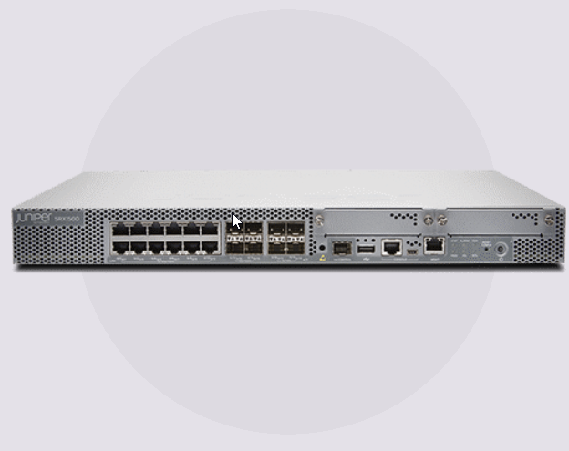
Using a Secure Firewall
Hospital must prioritize data security to protect patient health records and sensitive information.
A secure firewall is an essential security measure to prevent cyber threats and attacks.
It creates a barrier between a private internal network and the internet, protecting against unauthorized access and cyber threats.
The Juniper SRX1500 Firewall is an advanced level firewall that can provide hospital with high-performance security for their network.
Using a firewall will help mitigate DDOS attacks and SQL Injection attacks.
Juniper SRX1500

Slide 9
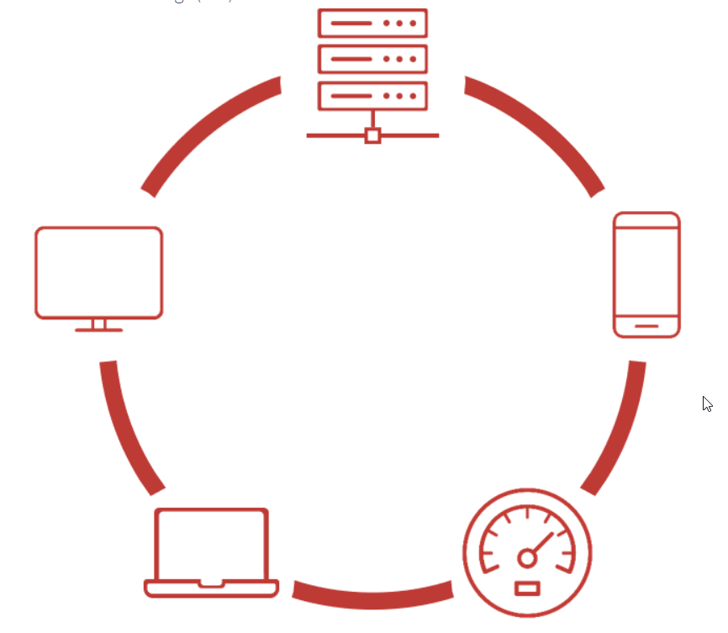
Implementing Endpoint Detection and Response
It will offer advanced threat detection and response capabilities, and provide a centralized console for logging and monitoring security alerts.
SIEM tool will help protect against insider threats by monitoring and detecting suspicious user activity, such as data exfiltration and unauthorized access to sensitive patient information.
Compliance frameworks, such as HIPAA, will require hospitals to implement endpoint security measures, to protect sensitive patient data.

Slide 10
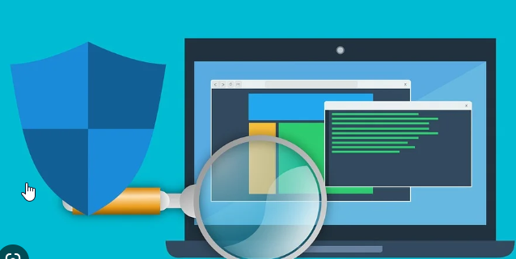
Deploying IPS, vulnerability scanners, Antimalware softwares and Scalability
IPS monitors network traffic and detects and block malicious activity before it can reach hospital systems, preventing potentially harmful attacks.
IPS and vulnerability scanners are part of a layered security approach, along with firewalls, antivirus software, and other security tools.
Vulnerability scanners like Nessus and Qualys can be used to detect vulnerabilities and mitigate the risks

Slide 11
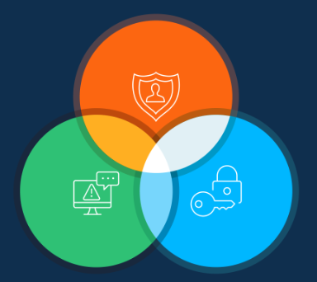
Encrypting and Hashing Sensitive data
Strong encryption and hashing algorithms are essential for protecting sensitive data and ensuring its confidentiality, integrity, and authenticity.
Encryption like AES, RSA, can help protect sensitive information, such as patient health records, from unauthorized access and data breaches.
Hashing algorithms like SHA-3, BLAKE2 can be used to securely store passwords and other sensitive data, making it more difficult for hackers to obtain and use the information.
Encryption can also be used to secure remote access to hospital systems and data, helping to prevent unauthorized access from outside the hospital network.
HIPAA, require the use of encryption to protect patient information.

Slide 12
Conclusion
Some of the systematic and general issues are identified during the security assessment of LifeCare Hospital
An analysis was conducted to identify any exploits and determine the cause of the theft of PII/PHI.
Few security solutions are recommend to improve the overall security posture of LifeCare Hospital and build resilience against future attacks and mitigate risks. Budget will be allocated in the report for infrastructure assessment and solutions design, which will provide an estimated cost for the recommended solutions.

Slide 13
Thank You

